Slide 1

Unit - 5 Introduction to LINQ
Advanced .NET
DU # 2101CS611
Prof. Madhuresh R Fichadiya
Computer Engineering Department
madhuresh.fichadiya@darshan.ac.in
8866961282

Slide 2

Looping
Outline
Introduction
Key Features
LINQ Architecture
Advantages/Disadvantages
IEnumerable and IQueryable interface
Lambda Expression
Different Ways to Write LINQ Queries
LINQ Operators

Slide 3
Introduction
5.1

Slide 4
Introduction
Suppose we are developing a .NET Application which requires data from different sources. For example,
The application needs data from the SQL Server Database. To access the data from the SQL Server Database, we need to understand ADO.NET and SQL Server-specific syntaxes. Same if we work with Oracle Database then we need to learn Query Syntax specific to database is oracle.
The application also needs data from an XML Document. To work with XML documents, we need to understand XPath and XSLT queries.
The application also needs to manipulate the data (objects) in memory, such as List<Products>, List<Orders>, etc. We should also have to understand how to work with in-memory objects.
Dot Net Application
ADO.NET
SQL
Databases
XSLT
XPATH
XML Document
Arrays
Generic Collections
In Memory Objects

Slide 5
Introduction
Microsoft introduced LINQ (Language Integrated Query) with .NET Framework 3.5 and C# 3.0, available in System.Linq namespace.
LINQ Queries are the first-class language construct in C# .NET, just like classes, methods, events.
LINQ provides a common syntax that allows us to query the data from various data sources uniformly.
The LINQ provides a consistent query experience to query objects (LINQ to Objects), relational databases (LINQ to SQL), and XML (LINQ to XML).
That means using a single LINQ query, we can get or set the data from various data sources such as SQL Server database, XML documents, ADO.NET Datasets, and any other in-memory objects such as Collections, Generics, etc.

Slide 6
LINQ Operators
The LINQ Operators are nothing but a set of extension methods used to write the LINQ Query.
These LINQ extension methods provide many useful features we can apply to the data source. Some of the features are filtering the data, sorting the data, grouping the data, etc.
Sr. | LINQ Operators
1 | Projection Operators
2 | Filtering Operator
3 | Aggregate Operators
4 | Sorting Operators

Slide 7
Projection(Selection) Operators
public class Student
{
public int Rno { get; set; }
public string Name { get; set; }
public string Branch { get; set; }
public int Sem { get; set; }
public double CPI { get; set; }
public static List<Student> GetStudents()
{
List<Student> students = new List<Student>
{
new Student { Rno=101, Name="Ramesh" ,Branch="CE" ,Sem=3 ,CPI=9},
new Student { Rno=102, Name="Mahesh" ,Branch="EC" ,Sem=3 ,CPI=8},
new Student { Rno=103, Name="Suresh" ,Branch="ME" ,Sem=4 ,CPI=7},
new Student { Rno=104, Name="Amit" ,Branch="EE" ,Sem=4 ,CPI=8},
new Student { Rno=105, Name="Anita" ,Branch="CE" ,Sem=4 ,CPI=8},
new Student { Rno=106, Name="Reeta" ,Branch="ME" ,Sem=3 ,CPI=7},
new Student { Rno=107, Name="Rohit" ,Branch="EE" ,Sem=4 ,CPI=9},
new Student { Rno=108, Name="Chetan" ,Branch="CE" ,Sem=3 ,CPI=8},
new Student { Rno=109, Name="Rakesh" ,Branch="CE" ,Sem=4 ,CPI=9}
};
return students;
}
}

Slide 8
Select Operator
Student
Rno | Name | Branch | Semester | CPI
101 | Ramesh | CE | 3 | 9
102 | Mahesh | EC | 3 | 8
103 | Suresh | ME | 4 | 7
104 | Amit | EE | 4 | 8
105 | Anita | CE | 4 | 8
106 | Reeta | ME | 3 | 7
107 | Rohit | EE | 4 | 9
108 | Chetan | CE | 3 | 8
109 | Rakesh | CE | 4 | 9
Example
Get all students
Answer
var studentList = Student.GetStudents();
Example
Display only student Name
Answer
var std = studentList.Select(s => s.Name);
Example
Display students with Rno and Name
Answer
var std = studentList .Select(s => s.Rno+ " - " + s.Name);

Slide 9
Select Operator
Student
Rno | Name | Branch | Semester | CPI
101 | Ramesh | CE | 3 | 9
102 | Mahesh | EC | 3 | 8
103 | Suresh | ME | 4 | 7
104 | Amit | EE | 4 | 8
105 | Anita | CE | 4 | 8
106 | Reeta | ME | 3 | 7
107 | Rohit | EE | 4 | 9
108 | Chetan | CE | 3 | 8
109 | Rakesh | CE | 4 | 9
Example
Select students Rno and Name to new class
Answer
IEnumerable<Student> std = studentList .Select(s => new Student() { Name = s.Name, Rno = s.Rno }).ToList();
Example
Display student info to anonymous
Answer
IEnumerable<Student> std = studentList .Select(s => new { Name = s.Name, Rno = s.Rno, Sem = s.Sem, CPI = s.CPI, Branch = s.Branch }).ToList();

Slide 10
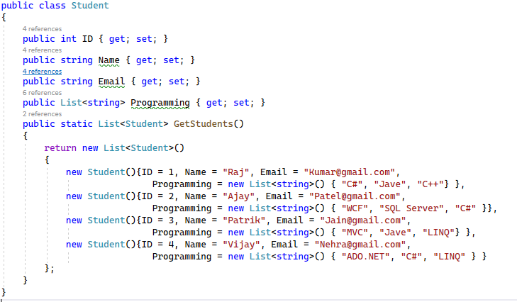
Select Many Operator

Slide 11
Select Many Operator
Example
Display programming languages to a list.
Answer
IEnumerable<string> studentList = Student.GetStudents() .SelectMany(s => s.Programming).ToList();
Example
Display distinct programming languages to a list.
Answer
IEnumerable<string> studentList = Student.GetStudents() .SelectMany(s => s.Programming).Distinct().ToList(); // will return distinct programming language list

Slide 12
Where Operator
public class Student
{
public int Rno { get; set; }
public string Name { get; set; }
public string Branch { get; set; }
public int Sem { get; set; }
public double CPI { get; set; }
public static List<Student> GetStudents()
{
List<Student> students = new List<Student>
{
new Student { Rno=101, Name="Ramesh" ,Branch="CE" ,Sem=3 ,CPI=9},
new Student { Rno=102, Name="Mahesh" ,Branch="EC" ,Sem=3 ,CPI=8},
new Student { Rno=103, Name="Suresh" ,Branch="ME" ,Sem=4 ,CPI=7},
new Student { Rno=104, Name="Amit" ,Branch="EE" ,Sem=4 ,CPI=8},
new Student { Rno=105, Name="Anita" ,Branch="CE" ,Sem=4 ,CPI=8},
new Student { Rno=106, Name="Reeta" ,Branch="ME" ,Sem=3 ,CPI=7},
new Student { Rno=107, Name="Rohit" ,Branch="EE" ,Sem=4 ,CPI=9},
new Student { Rno=108, Name="Chetan" ,Branch="CE" ,Sem=3 ,CPI=8},
new Student { Rno=109, Name="Rakesh" ,Branch="CE" ,Sem=4 ,CPI=9}
};
return students;
}
}

Slide 13
Where Operator
Student
Rno | Name | Branch | Semester | CPI
101 | Ramesh | CE | 3 | 9
102 | Mahesh | EC | 3 | 8
103 | Suresh | ME | 4 | 7
104 | Amit | EE | 4 | 8
105 | Anita | CE | 4 | 8
106 | Reeta | ME | 3 | 7
107 | Rohit | EE | 4 | 9
108 | Chetan | CE | 3 | 8
109 | Rakesh | CE | 4 | 9
Example
Select student whose Rno is 104
Answer
IEnumerable<Student> std = Student.GetStudents() .Where(s => s.Rno == 104);
Example
Select students whose Semester is 3
Answer
IEnumerable<Student> std = Student.GetStudents() .Where(s => s.Sem == 3);
Example
Select students whose Branch is either CE or EE
Answer
IEnumerable<Student> std = Student.GetStudents() .Where(s => s.Branch == "CE" || s.Branch=="EE");
Example
Select students whose Branch is ME and Sem is 4
Answer
IEnumerable<Student> std = Student.GetStudents() .Where(s => s.Branch == "CE" && s.Sem == 3);

Slide 14
Where Operator
Student
Rno | Name | Branch | Semester | CPI
101 | Ramesh | CE | 3 | 9
102 | Mahesh | EC | 3 | 8
103 | Suresh | ME | 4 | 7
104 | Amit | EE | 4 | 8
105 | Anita | CE | 4 | 8
106 | Reeta | ME | 3 | 7
107 | Rohit | EE | 4 | 9
108 | Chetan | CE | 3 | 8
109 | Rakesh | CE | 4 | 9
Example
Select student with CE branch and CPI more than 8
Answer
IEnumerable<Student> std = Student.GetStudents() .Where(s => s.Branch == "CE" && s.CPI > 8);
Select students whose Name starts with a and ignore the case
Example
Answer
IEnumerable<Student> std = Student.GetStudents() .Where(s => s.Name.StartsWith("a", StringComparison.InvariantCultureIgnoreCase));
Select students whose Rno between 103 and 107 and CPI more than 7 and Semester is 4
Example
Answer
IEnumerable<Student> std = Student.GetStudents() .Where(s=>s.Rno >= 103 && s.Rno<= 106 && s.CPI>7 && s.Sem ==4);

Slide 15
OfType Operator
List<object> list = new List<object>() { "Darshan",105, 101, "University", 5.555,99.99, new DateTime(2005, 11, 02), "Rajkot" };
Example
Retrieve int values from list
Answer
var intList = list.OfType<int>().ToList();
Example
Retrieve string values from list
Answer
var stringList = list.OfType<string>().ToList();
Example
Retrieve string values from list with string length more than 7
Answer
var stringList = list.OfType<string>().Where(s => s.Length > 7).ToList();
Example
Retrieve double values from list more than 10
Answer
var stringList = list.OfType<double>().Where(s => s > 10).ToList();

Slide 16
Aggregate Operators
public class Student
{
public int Rno { get; set; }
public string Name { get; set; }
public string Branch { get; set; }
public int Sem { get; set; }
public double CPI { get; set; }
public static List<Student> GetStudents()
{
List<Student> students = new List<Student>
{
new Student { Rno=101, Name="Ramesh" ,Branch="CE" ,Sem=3 ,CPI=9},
new Student { Rno=102, Name="Mahesh" ,Branch="EC" ,Sem=3 ,CPI=8},
new Student { Rno=103, Name="Suresh" ,Branch="ME" ,Sem=4 ,CPI=7},
new Student { Rno=104, Name="Amit" ,Branch="EE" ,Sem=4 ,CPI=8},
new Student { Rno=105, Name="Anita" ,Branch="CE" ,Sem=4 ,CPI=8},
new Student { Rno=106, Name="Reeta" ,Branch="ME" ,Sem=3 ,CPI=7},
new Student { Rno=107, Name="Rohit" ,Branch="EE" ,Sem=4 ,CPI=9},
new Student { Rno=108, Name="Chetan" ,Branch="CE" ,Sem=3 ,CPI=8},
new Student { Rno=109, Name="Rakesh" ,Branch="CE" ,Sem=4 ,CPI=9}
};
return students;
}
}

Slide 17
Aggregate Operators
Student
Rno | Name | Branch | Semester | CPI
101 | Ramesh | CE | 3 | 9
102 | Mahesh | EC | 3 | 8
103 | Suresh | ME | 4 | 7
104 | Amit | EE | 4 | 8
105 | Anita | CE | 4 | 8
106 | Reeta | ME | 3 | 7
107 | Rohit | EE | 4 | 9
108 | Chetan | CE | 3 | 8
109 | Rakesh | CE | 4 | 9
Example
Find total number of students
Answer
var studentCount = Student.GetStudents().Count();
Example
Find total students of 3rd semester
Answer
var student = Student.GetStudents() .Where(s => s.Sem == 3).Count();
Example
Find Minimum CPI
Answer
var student = Student.GetStudents() .Min(x => x.CPI);
Example
Find Maximum CPI of CE Branch
Answer
var student = Student.GetStudents() .Where(s => s.Branch == "CE").Max(x => x.CPI);

Slide 18
Aggregate Operators
Student
Rno | Name | Branch | Semester | CPI
101 | Ramesh | CE | 3 | 9
102 | Mahesh | EC | 3 | 8
103 | Suresh | ME | 4 | 7
104 | Amit | EE | 4 | 8
105 | Anita | CE | 4 | 8
106 | Reeta | ME | 3 | 7
107 | Rohit | EE | 4 | 9
108 | Chetan | CE | 3 | 8
109 | Rakesh | CE | 4 | 9
Example
Find Average CPI of ME Branch
Answer
var student = Student.GetStudents() .Where(s => s.Branch == "ME").Average(x => x.CPI);
Example
Find Average CPI of 4rd Semester
Answer
var student = Student.GetStudents() .Where(s => s.Sem == 4).Average(x => x.CPI);
Example
Find total students whose CPI more than 8
Answer
var student = Student.GetStudents() .Count(s => s.CPI > 8);
Example
Find average CPI of 3rd semester CE branch students
Answer
var student = Student.GetStudents() .Where(s=>s.Branch =="CE" && s.Sem == 3) .Average(s => s.CPI);

Slide 19
Sorting Operators
public class Employee
{
public int Id { get; set; }
public string FirstName { get; set; }
public string LastName { get; set; }
public string Branch { get; set; }
public static List<Employee> GetEmployees()
{
List<Employee> employees = new List<Employee>() {
new Employee(){Id=101 ,FirstName="Preety" ,LastName="Tiwari" ,Branch="Admin"},
new Employee(){Id=102 ,FirstName="Preety" ,LastName="Agrawal" ,Branch="HR"},
new Employee(){Id=103 ,FirstName="Priyanka" ,LastName="Dewagan" ,Branch="IT"},
new Employee(){Id=104 ,FirstName="Hina" ,LastName="Sharma" ,Branch="HR"},
new Employee(){Id=105 ,FirstName="Anurag" ,LastName="Mohanty" ,Branch="IT"},
new Employee(){Id=106 ,FirstName="Anurag" ,LastName="Sharma" ,Branch="Admin"},
new Employee(){Id=107 ,FirstName="Pranaya" ,LastName="Kumar" ,Branch="IT"},
new Employee(){Id=108 ,FirstName="Manoj" ,LastName="Kumar" ,Branch="HR"},
new Employee(){Id=109 ,FirstName="Pranaya" ,LastName="Rout" ,Branch="Admin"},
new Employee(){Id=110 ,FirstName="Saurav" ,LastName="Rout" ,Branch="IT" },
};
return employees;
}
}

Slide 20
Sorting Operators
Employee
Id | FirstName | LastName | Branch
101 | Preety | Tiwari | Admin
102 | Preety | Agrawal | HR
103 | Priyanka | Dewagan | IT
104 | Hina | Sharma | HR
105 | Anurag | Mohanty | IT
106 | Anurag | Sharma | Admin
107 | Pranaya | Kumar | IT
108 | Manoj | Kumar | HR
109 | Pranaya | Rout | Admin
110 | Saurav | Rout | IT
Example
Display Employees in ascending order by FirstName
Answer
var empList = Employee.GetEmployees() .OrderBy(x => x.FirstName);
Example
Display Employees in descending order by Branch
Answer
var empList = Employee.GetEmployees() .OrderByDescending(x => x.Branch);
Display Employees in ascending order by FirstName and descending order by LastName
Example
Answer
var empList = Employee.GetEmployees() .OrderBy(x => x.FirstName) .ThenByDescending(x=>x.LastName);

Slide 21
Lambda Expression
5.6

Slide 22
Lambda Expression
The lambda expression is a shorter way of representing anonymous method using some special syntax.
For example,
Structure of Lambda Expression:
num => num * 7
Lambda Operator
num => num*7
Body Expression
Parameter

Slide 23
Lambda Expression
Types of Lambda Expression
Expression Lambda
Statement Lambda
Expression Lambda: Expression lambda contains a single expression in the lambda body. For example,
Statement Lambda: Statement lambda encloses one or more statements in the lambda body. For example,
Ex.1
(int num) => num * 5;
Ex.2
(Student s, int Age) => s.Age >= Age;
Ex.1
(int a, int b) => {
var sum = a + b;
return sum;
};
Ex.2
(s, youngAge) => {
Console.WriteLine(“Multiple statements in the body");
Return s.Age >= youngAge;
}

Slide 24
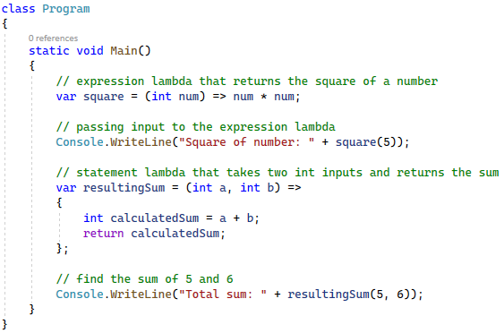
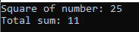
Example
Output:

Slide 25
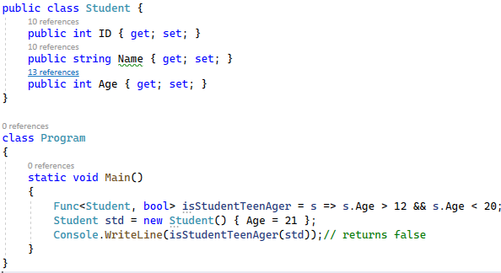
Lambda Expression with Delegate
The lambda expression can be assigned to Func<in T, out TResult> type delegate.
The last parameter type in a Func delegate is the return type and rest are input parameters.
For Example,

Slide 26
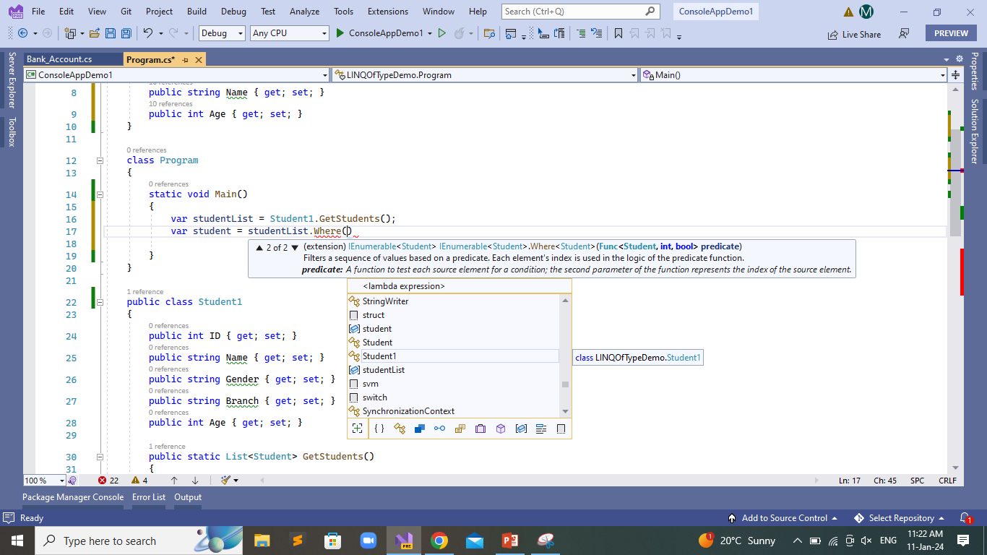
Lambda Expression in LINQ Query
Usually lambda expression is used with LINQ query. Enumerable static class includes Where extension method for IEnumerable<T> that accepts Func<TSource,bool>.
The Where() extension method for IEnumerable<Student> collection is required to pass Func<Student,bool>, as shown below:
Function Delegate

Slide 27
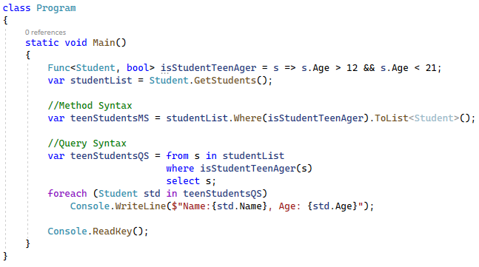
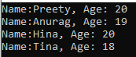
Example
Output:

Slide 28
Different Ways to Write LINQ Queries
5.7

Slide 29
Different Ways to Write LINQ Queries
There are two basic ways to write a LINQ query to IEnumerable collection or IQueryable data sources.
Query Syntax or Query Expression Syntax
Method Syntax or Method Extension Syntax

Slide 30
Query Syntax
Query syntax is similar to SQL (Structured Query Language) for the database. It is defined within the C# code.
It starts with a from clause followed by a range variable and includes standard query operations like where, select, group, join, etc.
LINQ Query Syntax:
from <range variable> in < IEnumerable<T> or IQueryable<T> Collection >
<Standard Query Operators> <lambda expression>
<select or groupBy operator> <result formation>

Slide 31
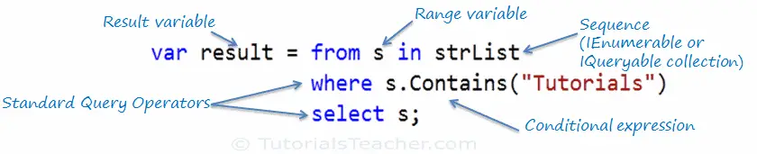
Example - 1
LINQ query that returns a collection of strings which contains a word "Tutorials".
// string collection
IList<string> stringList = new List<string>()
{
"C# Tutorials", "VB.NET Tutorials", "Learn C++", "MVC Tutorials", "Java"
};
// LINQ Query Syntax
var result = from s in stringList where s.Contains("Tutorials") select s;

Slide 32
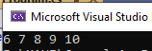
Example - 2
class Program
{
static void Main(string[] args)
{
//Step1: Data Source
List<int> integerList = new List<int>()
{
1, 2, 3, 4, 5, 6, 7, 8, 9, 10
};
//Step2: Query
//LINQ Query using Query Syntax to fetch all numbers which are > 5
var QuerySyntax = from obj in integerList //Data Source
where obj > 5 //Condition
select obj; //Selection
//Step3: Execution
foreach (var item in QuerySyntax)
{
Console.Write(item + " ");
}
}
}
Output:

Slide 33
LINQ Method Syntax
Method syntax (also known as fluent syntax) uses extension methods included in the Enumerable or Queryable static class, similar to how you would call the extension method of any class.
The compiler converts query syntax into method syntax at compile time.

Slide 34
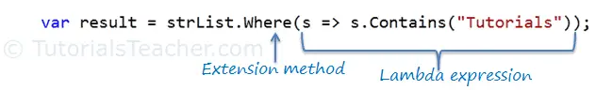
Example - 1
LINQ query that returns a collection of strings which contains a word "Tutorials".
// string collection
IList<string> stringList = new List<string>()
{
"C# Tutorials", "VB.NET Tutorials", "Learn C++", "MVC Tutorials", "Java"
};
// LINQ Method Syntax
var result = stringList.Where(s => s.Contains("Tutorials"));

Slide 35
Example - 2
LINQ query that returns a collection of students
public class Student
{
public int StudentID { get; set; }
public string StudentName { get; set; }
public int Age { get; set; }
}
public class Program
{
static void Main(string[] args)
{
// Student collection
IList<Student> studentList = new List<Student>(){
new Student() { StudentID = 1, StudentName = "Raj", Age = 19}
, new Student() { StudentID = 2, StudentName = "Karan", Age = 23 }
, new Student() { StudentID = 3, StudentName = "Mohit", Age = 27 }
, new Student() { StudentID = 4, StudentName = "Ram" , Age = 20}
, new Student() { StudentID = 5, StudentName = "Laxman" , Age = 12 }
};

Slide 36
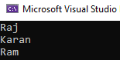
Example - 2 Cont..
// LINQ Method Syntax to find student age betwen 18 to 24
var Students = studentList
.Where(s => s.Age > 18 && s.Age < 24)
.ToList<Student>();
foreach (var student in Students)
{
Console.WriteLine(student.StudentName);
}
}
}
Output:

Slide 37
LINQ Operators
5.8

Slide 38
LINQ Operators
The LINQ Operators are nothing but a set of extension methods used to write the LINQ Query.
These LINQ extension methods provide many useful features we can apply to the data source. Some of the features are filtering the data, sorting the data, etc.
Categories of LINQ Operators
Projection Operators
Filtering Operator
Aggregate Operators
Ordering Operators

Slide 39
LINQ Projection Operators
Projection in LINQ is nothing but a mechanism used to select the data from a data source. You can select the data in the same form (i.e., the original one).
Projection is an operation that transforms an object into a new form that often consists of only the properties which we use frequently.
There are two methods for projection operator:
Select
SelectMany

Slide 40
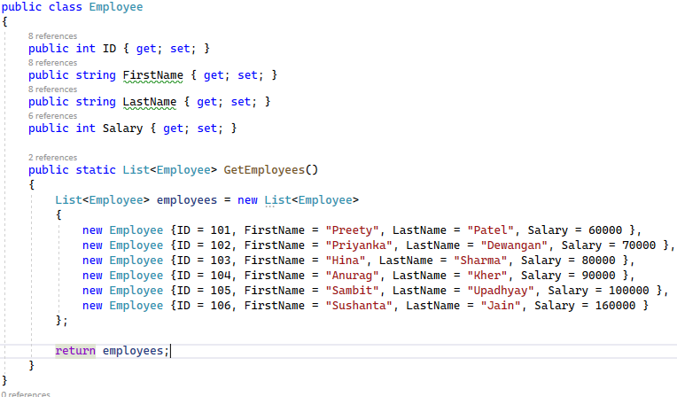
Select Operator
This Operator or Method can be used to return a scaler value, a custom class, or a collection of custom classes. or anonymous type, which includes properties as per our requirements.
Example

Slide 41
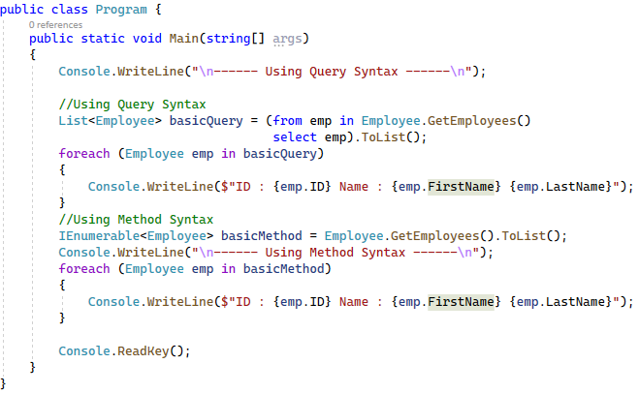
Select Operator - Example

Slide 42
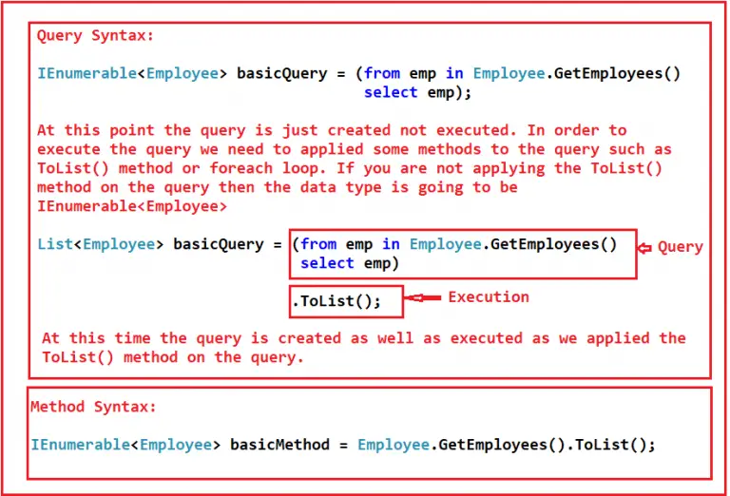
Select Operator - Example

Slide 43
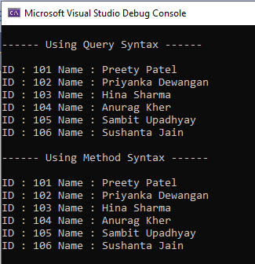
Select Operator - Example
Output

Slide 44
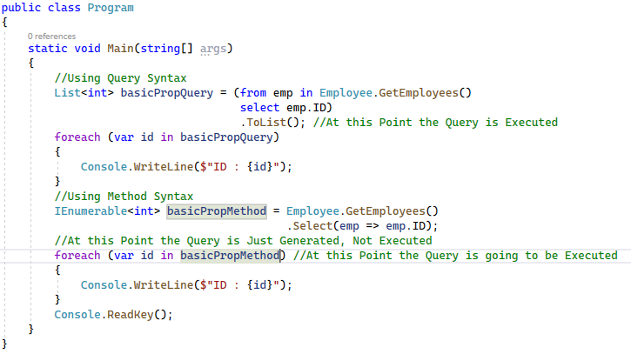
Select Operator – Select Specific Property

Slide 45
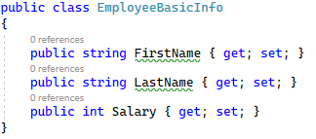
Select Operator – Select a specific properties to a different class

Slide 46
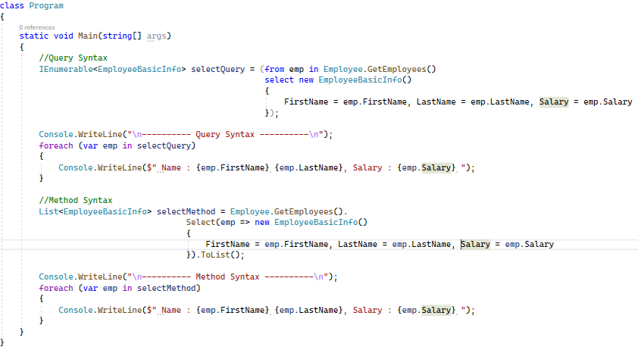
Select Operator – Select a specific properties to a different class

Slide 47
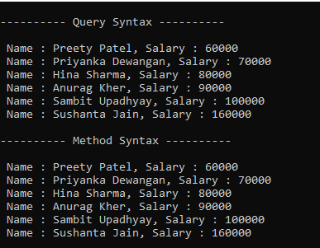
Select Operator – Select a specific properties to a different class
Output

Slide 48
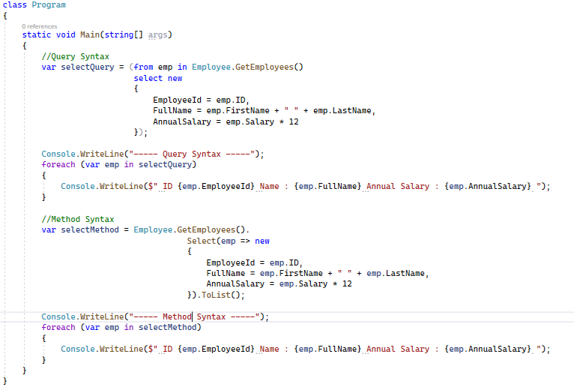
Select Operator - Project the Data to Anonymous

Slide 49
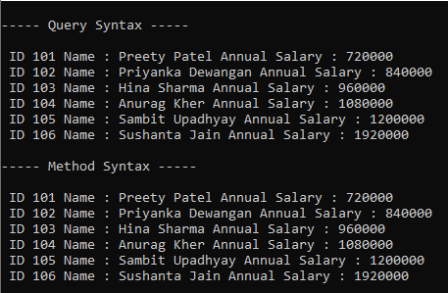
Select Operator - Project the Data to Anonymous
Output

Slide 50
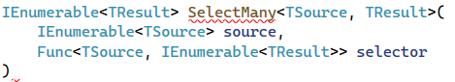
Select Many Operator
The LINQ SelectMany method is used to project each element of a sequence or collection or data source element to an IEnumerable<T> type and flatten the resulting sequences into one sequence.
That means the SelectMany projection method combines the records from a sequence of results and then converts them into one result.
The general syntax for SelectMany is as follows:
source: This is the input sequence, typically a collection of elements.
selector: A function that takes an element from the input sequence and returns an IEnumerable<TResult>. This function is applied to each element in the source sequence, and the results are flattened into a single sequence.

Slide 51
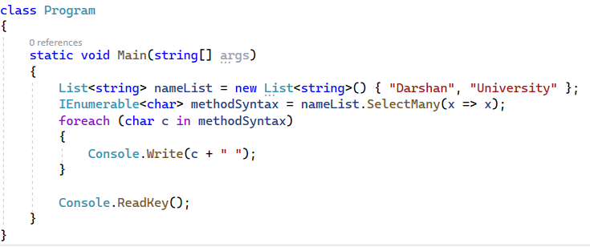
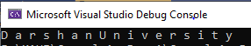
Select Many Operator Example
Output

Slide 52
Select Many Operator Example

Slide 53
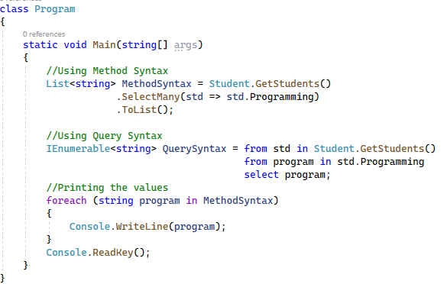
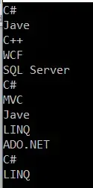
Select Many Operator Example
Output

Slide 54
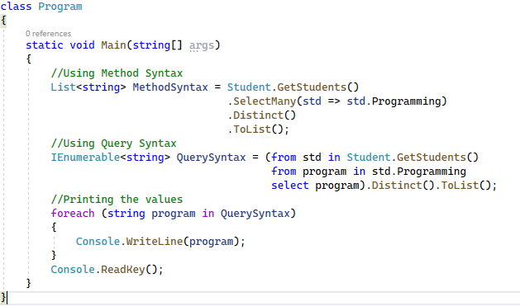
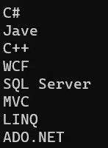
Select Many Operator Example - Remove Duplicates
Output

Slide 55
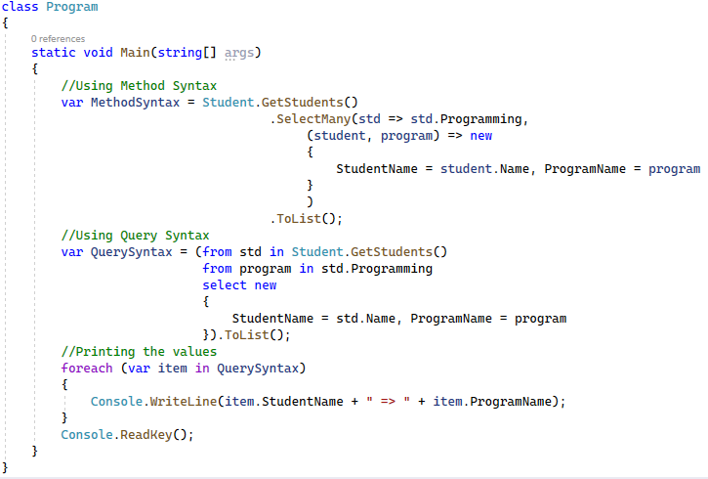
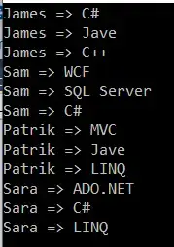
Select Many Operator Example - Complex Types
Output

Slide 56
Filtering Operator
Filtering is nothing but the process of getting only those elements from a data source that satisfies the given condition.
It is also possible to fetch the data from a data source with more than one condition as per our business requirements. For example:
Employees having a salary greater than 50000.
Students Having Marks greater than 80% from a particular batch.
Employees having experience of more than 6 Years and the department is IT, etc.
Types of Filtering Operator
Where - used to select values from the list based on predicate functions.
OfType - used to select values based on their ability to caste a specified type.

Slide 57
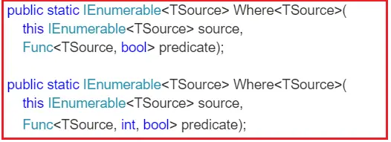
Where Filtering Operator or Method
The LINQ Where Method is used for filtering collections based on a predicate that takes each element in the collection and returns a boolean value.
If the function returns true for an element, it is included in the result; otherwise, it’s excluded.
The conditions can be written using the ==, >=, <=, &&, ||, >, <, etc. symbols.
Two overloaded versions of the “Where” Method are available in LINQ. They are as follows:
Above methods are implemented as extension methods on the IEnumerable<T> interface. The methods accept a predicate as a parameter.

Slide 58
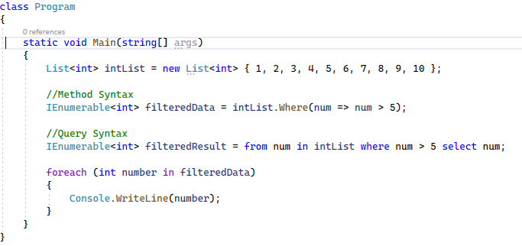
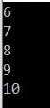
What is a Predicate?
A Predicate is nothing but a function, or a delegate used to test every element for a given condition. For example,
Output:

Slide 59
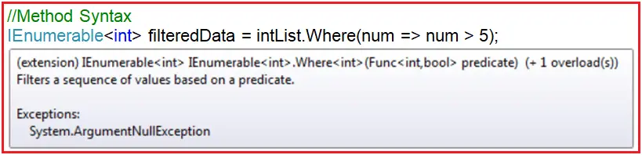
What is a Predicate?
Visual Studio Intelligence shows the following when you hover the mouse over the WHERE extension method in the above example.
the Predicate (Func<int, bool> predicate) expects one input parameter of type integer, and it returns a boolean value.
The Func is a generic delegate that takes one or more input parameters and returns one out parameter. The last parameter is considered the return value.
The return type is mandatory, but the input parameter is not.

Slide 60
What is a Predicate?
Following syntax is for 2nd overloaded method for predicate.

Slide 61
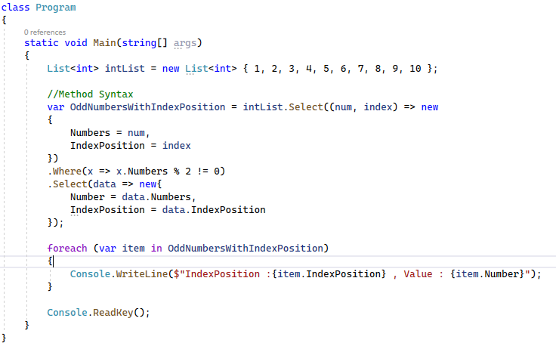
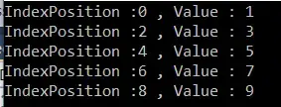
Where Filtering Operator or Method - Example
Here, we need to filter only the odd numbers, i.e., those not divisible by 2.
Along with the numbers, we also need to fetch the index position of the number. The index is 0 based.
Output:

Slide 62
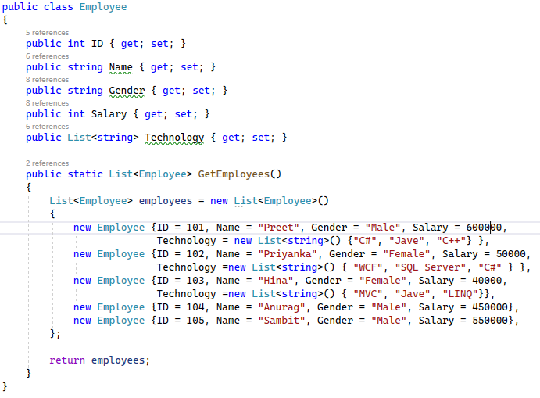
Example - Specify Multiple Conditions using LINQ Where Method
Fetch all employees whose gender is Male and Salary is greater than 500000.

Slide 63
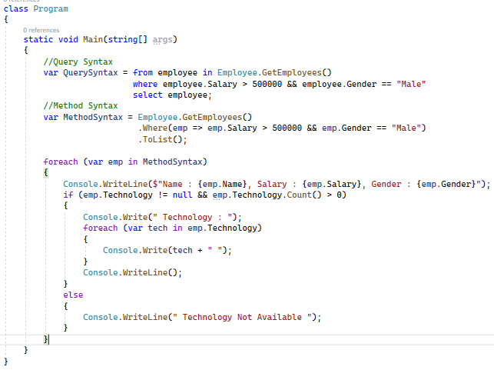
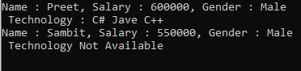
Example - Specify Multiple Conditions using LINQ Where Method
Output

Slide 64
OfType Operator
The LINQ OfType Operator filters specific data from a data source based on the data type we passed to this operator.
For example, if we have a collection that stores integer and string values, and if we need to fetch either the integer values or only the string values from that collection, then we need to use the LINQ OfType Operator.
Signature of the LINQ OfType Method:
The OfType operator in LINQ filters a sequence, returning only those elements that can be cast to a specified type.
This is particularly useful when dealing with a non-generic IEnumerable or a collection of objects of various types. You only want to work with elements of a particular type.

Slide 65
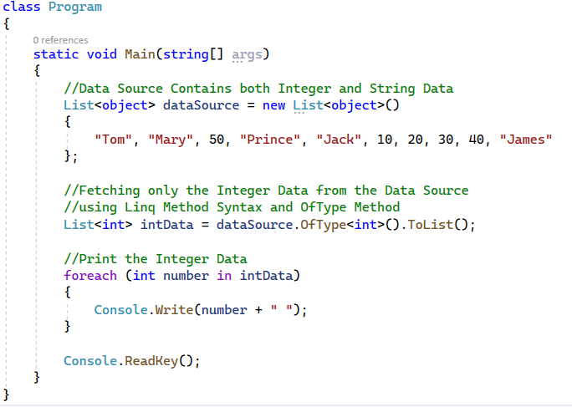
Example - Retrieve int values from collection
Output:

Slide 66
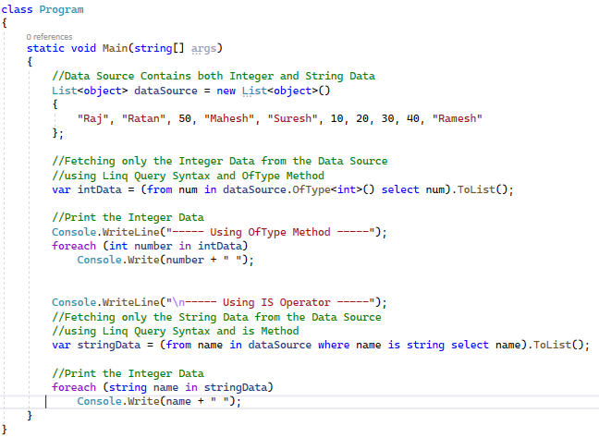
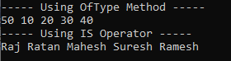
LINQ OfType Operator Using Query Syntax
Output:

Slide 67
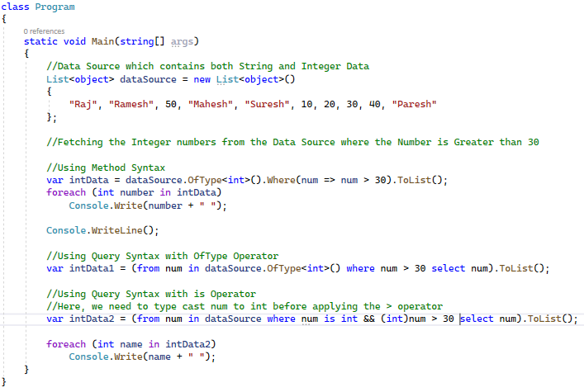
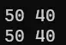
LINQ OfType Operator with Where Condition
Output:

Slide 68
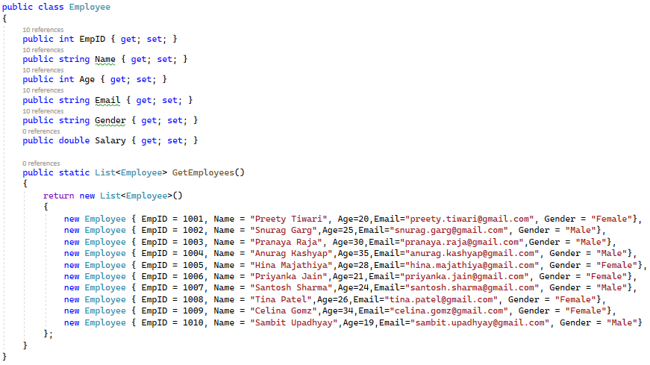
Try it Yourself !!

Slide 69
Try it Yourself !!
Select data of all candidates whose age is greater than 25.
Select data of all female candidates.
Select all data whose age between 25 to 30.
Select all records of female candidates whose EmpId is between 1003 to 1006.
Select the data of candidates whose name is Anurag Kashyap.
Select the data of candidates whose age is 30.
Select the data of candidates whose name start with ‘H’.
Select the data of candidates who is containing ‘garg’ in email id.
Select the data of candidates whose name having Kashyap.
Select the data of candidates whose name contains ya.
Select the data of candidates whose age is either 20,30 or 35.

Slide 70
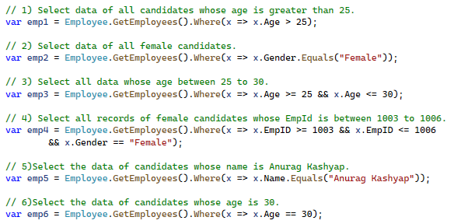
Solution

Slide 71
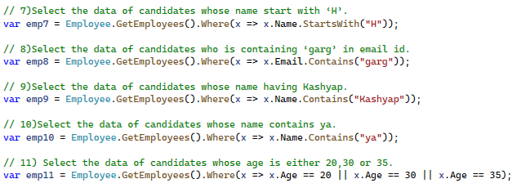
Solution

Slide 72
LINQ Aggregate Operators
Aggregate Operators perform mathematical operations on sequences of numeric data and are also used to compute a single value from a sequence of values.
So, in simple words, we can say that the aggregate methods will always return a single value.
LINQ provides aggregate operators that allow you to perform aggregate calculations on elements in a collection or sequence, such as sum, average, minimum, maximum, and more.
These operators help you summarize and extract useful information from your data.
Types of Aggregate operator:
Sum() – to calculate the collection’s total(sum) value
Min() – to find the smallest value in the collection
Max() – to find the largest value in the collection
Count() – to count the number of elements in the collection
Average() – to calculate the average value of the numeric type of the collection
Aggregate() – to Perform a custom aggregation operation on the values of a collection

Slide 73
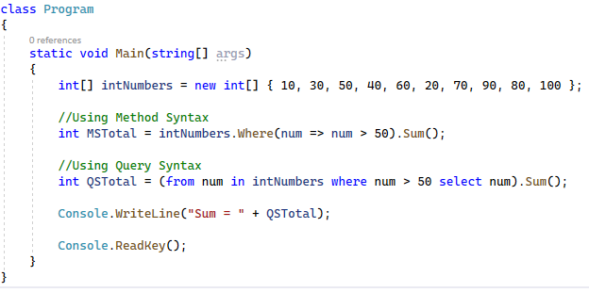
1. Sum()
It’s a part of the System.Linq namespace can be used with arrays, lists, or any type that implements IEnumerable<T>.
Syntax: int sum = collection.Sum(element => element.Value);
Example:
Output:

Slide 74
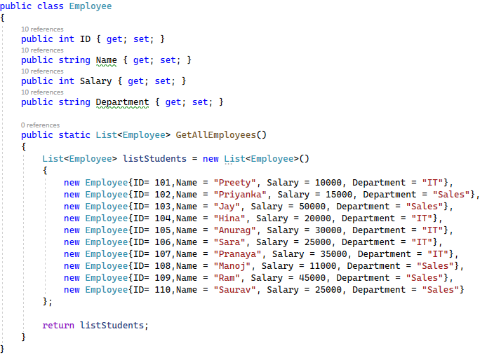
Example - Calculate total salary of Sales department

Slide 75
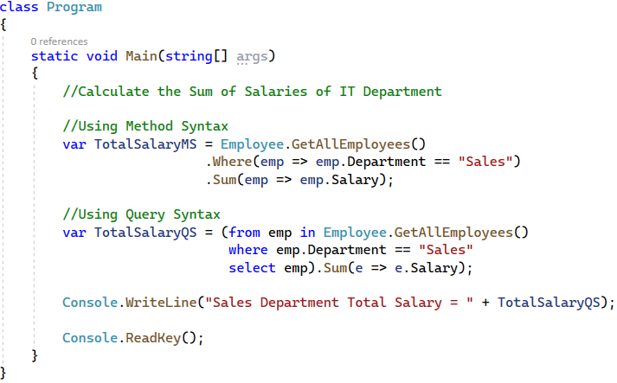
Example - Calculate total salary of Sales department
Output:

Slide 76

2. Min()
Returns the minimum value in a sequence. The Min operator returns the minimum value from a collection of elements.
Syntax: T min = collection.Min();
Example:
Output:

Slide 77
Example - Find minimum salary of IT department

Slide 78


Example - Find minimum salary of IT department
Output:

Slide 79

3. Max()
Returns the maximum value in a sequence. The Max operator returns the maximum value from a collection of elements.
Syntax: T max = collection.Max();
Example:
Output:

Slide 80
Example - Find maximum salary of Sales department

Slide 81


Example - Find maximum salary of Sales department
Output:

Slide 82

4. Count()
Returns the number of elements in a collection that satisfy a specified condition.
It’s part of the System.Linq namespace can be used with arrays, lists, or any type that implements IEnumerable<T>.
Syntax: int count = collection.Count(element => condition);
Example:
Output:

Slide 83
Example - Count total employees in IT department

Slide 84


Example - Count total employees in IT department
Output:

Slide 85


5. Average()
Computes the average of a sequence of numeric values. The Average operator calculates the average of numeric values in a collection.
Syntax: double average = collection.Average(element => element.Value);
Example:
Output:

Slide 86
Example - Average Salary of IT department

Slide 87


Example - Average Salary of IT department
Output:

Slide 88
6. Aggregate()
The LINQ Aggregate Method performs a custom aggregation operation on the elements of a sequence.
This method applies a function that you define to each element in sequence, carrying the result forward as it processes the elements one by one.
It’s essentially a way to “accumulate” a result by applying a function that can combine each item with the current accumulated result.
Syntax:
TResult result = collection.Aggregate(seed, (accumulator, element) => aggregationFunction);

Slide 89


Example - Product of Integer Numbers
Without LINQ Aggregate Method
With LINQ Aggregate Method
How does the above Aggregate Method work?
Step 1: First, it multiplies (3X5) to produce the result of 15
Step 2: The result of Step 1, i.e., 15, is then multiplied by 7 to produce the result as 105
Step 3: The result of Step 2, i.e., 105, is multiplied by 9 to produce the final result as 945.

Slide 90

Aggregate Method With the Seed Parameter
The second overloaded version of the Aggregate method takes the first parameter as the seed value to accumulate. The Second parameter is Func type delegate.
Example:
How Does It Work?
Step 1: First, it multiplies (2*3) to produce the result as 6
Step 2: The result of Step 1, i.e., 6, is then multiplied by 5 to produce the result as 30
Step 3: The result of Step 2, i.e., 30, is then multiplied by 7 to produce the result as 210.
Step 4: The result of Step 3, i.e., 210, is then multiplied by 9 to produce the final result as 1890.

Slide 91

Example

Slide 92


Example - Calculate total salary
Output:

Slide 93


Aggregate Method with Result Selector
The third overload version requires the third parameter of the Func delegate expression for the result selector to formulate the result.
Example:

Slide 94

Try it Yourself !!

Slide 95
Try it Yourself !!
Find highest salary.
Find total employees.
Find minimum salary of HR department.
Count total number of cities of employee without duplication.
Count the number of employees living in Rajkot.
Display the total number of employees hired before 1st January, 2001.
Display total salary of all employees.
Display average salary of IT Department.
Find minimum salary of employee who belongs to Ahmedabad.
Find Average Salary of Admin Department.

Slide 96
Solution
//1. Find highest salary
var q1 = Employee.GetEmployees()
.Max(x => x.Salary);
//2. Find total employees
var q2 = Employee.GetEmployees()
.Count();
//3. Find minimum salary of HR department
var q3 = Employee.GetEmployees()
.Where(x => x.Department == "HR").Min(x => x.Salary);
//4. Count total number of cities of employee without duplication.
var q4 = Employee.GetEmployees()
.Select(x => x.City).Distinct().Count();
//5. Count the number of employees living in Rajkot.
var q5 = Employee.GetEmployees()
.Where(x => x.City == "Rajkot").Count();

Slide 97
Solution
//6. Display the total number of employees hired before 1st January, 2001.
var q6 = Employee.GetEmployees()
.Where(x => x.JoiningDate < Convert.ToDateTime("2000/01/01")).Count();
//7. Display total salary of all employees
var q7 = Employee.GetEmployees()
.Sum(x => x.Salary);
//8. Display average salary of IT Department
var q8 = Employee.GetEmployees()
.Where(x => x.Department == "IT").Average(x => x.Salary);
//9. Find minimum salary of employee who belongs to Ahmedabad.
var q9 = Employee.GetEmployees()
.Where(x => x.City == "Ahmedabad").Min(x => x.Salary);
//10. Find Average Salary of Admin Department
var q10 = Employee.GetEmployees()
.Where(x => x.Department == "Admin").Average(x => x.Salary);

Slide 98
LINQ Sorting Operators
Ordering is nothing but a process to manage the data in a particular order.
It does not change the data; rather, this operation rearranges data in a particular order, i.e., ascending or descending
Different Types of Ordering Operators in LINQ
OrderBy
OrderByDescending
ThenBy
ThenByDescending
Reverse

Slide 99


OrderBy
The OrderBy operator sorts elements in ascending order based on a specified key.
We can also use OrderBy with an additional descending keyword to sort in descending order.

Slide 100

Example - Display CSE Branch students with Name in ascending order

Slide 101


Example - Display CSE Branch students with Name in ascending order

Slide 102

OrderByDescending
The LINQ OrderByDescending Method in C# is used to sort elements in a sequence in descending order according to a specified key.
This is an extension method of the IEnumerable<T> and IQueryable<T> types and is found in the System.Linq namespace.

Slide 103
Example - Display students with Branch in descending order

Slide 104


Example - Display students with Branch in descending order
Output:

Slide 105
ThenBy & ThenByDescending
When we want to sort the data based on multiple values or expressions, we need to use the LINQ ThenBy and ThenByDescending Method along with the OrderBy or OrderByDescending Method.
The LINQ ThenBy or ThenByDescending Methods are used for secondary sorting.
It is not possible to use these two methods with primitive data types as we are going to sort the data based on multiple keys.

Slide 106
Example

Slide 107


Example - 1
Output:

Slide 108


Example - 2
Output:

Slide 109
Reverse
The reverse operator is used to reverse the order of the sequence or collection.
Unlike the OrderBy Method, it does not consider the actual value in itself in determining the order, instead of this, it returns the items in the reverse order in which they actually present.
For example, the collection is present in ascending order when you use the Reverse Method on the given collection it reverses the order of the collection, i.e., in descending order.
It does not support query syntax.

Slide 110

Example

Slide 111

Example
public class Program
{
public static void Main()
{
var empList = Employee.GetEmployees().OrderBy(x => x.Branch).Reverse();
foreach (var emp in empList)
{
Console.WriteLine($"Name: {emp.FirstName} - {emp.LastName}, Branch: {emp.Branch}");
}
}
}
Output:

Slide 112
LINQ GroupBy
The GroupBy method is used for organizing and categorizing data into groups.
It enables us to group elements in a collection based on a specified key and perform operations on each group.
GroupBy Method groups elements that share a common attribute, allowing us to perform operations on each group.
Each group is represented by an IGrouping<TKey, TElement> object, where TKey is the type of the key, and TElement is the type of the elements in the group.

Slide 113
LINQ GroupBy
Syntax
var groups = source.GroupBy(x => new { x.Column1, x.Column2, ... });
Source: This is the data source that we want to group.
Column1, Column2, ... : These are the column names that we want to group by. We can include as many columns as we want, separated by commas.
x : This is a placeholder variable that represents each item in the data source.
new { x.Column1, x.Column2, ... } : This is an anonymous type that contains the columns we want to group by.

Slide 114

Example

Slide 115


Example - Grouping the Students Based on the Branch
Output:

Slide 116
Example – Group By Multiple Columns
public class Teacher
{
public string name { get; set; }
public string subject { get; set; }
public int age { get; set; }
}
public class Program
{
public static void Main()
{
// Initializing List of Teacher objects
List<Teacher> teachers = new List<Teacher>()
{
new Teacher { name = "Ramesh", subject = "Web Technology", age = 35 },
new Teacher { name = "Suresh", subject = "App Development", age = 27 },
new Teacher { name = "Mahesh", subject = "Game Development", age = 39 },
new Teacher { name = "Pravin", subject = "Web Development", age = 35 },
new Teacher { name = "Chirag", subject = "App Development", age = 25 },
new Teacher { name = "Raj", subject = "Game Development", age = 39 },
new Teacher { name = "Darshan", subject = "Web Development", age = 32 },
new Teacher { name = "Niraj", subject = "App Development", age = 27 }
};

Slide 117

Example – Group By Multiple Columns (Group By Subject, Age)
// Group by multiple columns
var grouped_teachers = teachers
.GroupBy(t => new { t.subject, t.age })
.Select(g => new
{
subject = g.Key.subject,
age = g.Key.age,
count = g.Count(), //number of teachers in the group
names = string.Join(", ", g.Select(t => t.name)) // teacher names
});
// Output
foreach (var group in grouped_teachers)
{
Console.WriteLine($"Subject: {group.subject}, Age: {group.age}, Count: {group.count},
Names: {group.names}");
}
}
}
Output:

Slide 118
IEnumerable and IQueryable interface
5.5

Slide 119

IEnumerable
IEnumerable is an interface available in the System.Collection namespace.
The IEnumerable interface is a type of iteration design pattern. It means we can iterate on the collection of the type IEnumerable.
The IEnumerable interface has one method called GetEnumerator, which will return an IEnumerator that iterates through a collection.

Slide 120

IEnumerable
The IEnumerable interface also has a child generic interface, i.e., IEnumerable<T>.
All the collection classes (both generic and non-generic) implement the IEnumerable interface.
For example, List<T> generic collection class and ArrayList collection, a non-generic collection class.

Slide 121
IEnumerable
IEnumerator
Application
All Records
Database
In-memory Filter
IEnumerable Example :
IEnumerable<Employee> list = Employees.Where(p => p.Name.StartsWith("S"));
list = list.Take<Employee>(10);
Generated SQL statements of the above query will be :
SELECT [t0].[EmpID], [t0].[EmpName], [t0].[Salary] FROM [Employee] AS [t0]
WHERE [t0].[EmpName] LIKE @p0

Slide 122

Enumerable class
The Enumerable class includes extension methods for the classes that implement IEnumerable<T> interface.
For example all the built-in collection classes implement IEnumerable<T> interface and so we can write LINQ queries to retrieve data from the built-in collections.

Slide 123
Example
public class Student
{
public int ID { get; set; }
public string Name { get; set; }
public string Gender { get; set; }
}
public class Program
{
static void Main(string[] args)
{
List<Student> studentList = new List<Student>()
{
new Student(){ID = 1, Name = "Raj", Gender = "Male"},
new Student(){ID = 2, Name = "Swati", Gender = "Female"},
new Student(){ID = 3, Name = "Nidhi", Gender = "Female"},
new Student(){ID = 4, Name = "Pranav", Gender = "Male"}
};

Slide 124

Example
//Linq Query to Fetch all students with Gender Male
IEnumerable<Student> QuerySyntax = from std in studentList
where std.Gender == "Male"
select std;
//Iterate through the collection
foreach (var student in QuerySyntax)
{
Console.WriteLine($"ID : {student.ID} Name : {student.Name}");
}
Console.ReadKey();
}
}
Output:

Slide 125

IQueryable
The IQueryable is an interface, and it is available in the System.Linq namespace.
IQuerable interface is a child of the IEnumerable interface.
So we can store IQueryable in a variable of type IEnumerable.

Slide 126

IQueryable
IQuerable interface has a property called Provider, which is of type IQueryProvider interface.
The methods provided by the IQueryProvider are used to create all Linq Providers. So, this is the best choice for other data providers such as Linq to SQL, Linq to Entities, etc.

Slide 127
IQueryable
IQueryable
Application
Only Requested Records
Database
(Database Filter)
IQueryable Example :
IQueryable<Employee> list = Employees.Where(p => p.Name.StartsWith("S"));
list = list.Take<Employee>(10);
Generated SQL statements of the above query will be :
SELECT TOP 10 [t0].[EmpID], [t0].[EmpName], [t0].[Salary] FROM [Employee] AS [t0]
WHERE [t0].[EmpName] LIKE @p0

Slide 128
Queryable class
The Queryable class includes extension methods for classes that implement IQueryable<T> interface.
The IQueryable<T> interface is used to provide querying capabilities against a specific data source where the type of the data is known.
For example, Entity Framework api implements IQueryable<T> interface to support LINQ queries with underlying databases such as MS SQL Server.
Also, there are APIs available to access third party data; for example, LINQ to Amazon provides the ability to use LINQ with Amazon web services to search for books and other items. This can be achieved by implementing the IQueryable interface for Amazon.

Slide 129

Queryable class
The following figure shows the extension methods available in the Queryable class can be used with various native or third party data providers.

Slide 130
Example
public class Student
{
public int ID { get; set; }
public string Name { get; set; }
public string Gender { get; set; }
}
public class Program
{
static void Main(string[] args)
{
List<Student> studentList = new List<Student>()
{
new Student(){ID = 1, Name = "Raj", Gender = "Male"},
new Student(){ID = 2, Name = "Swati", Gender = "Female"},
new Student(){ID = 3, Name = "Nidhi", Gender = "Female"},
new Student(){ID = 4, Name = "Pranav", Gender = "Male"}
};

Slide 131
Example
//Linq Query to Fetch all students with Gender Male
IQueryable<Student> MethodSyntax = studentList.AsQueryable()
.Where(std => std.Gender == "Male");
//Iterate through the collection
foreach (var student in QuerySyntax)
{
Console.WriteLine($"ID : {student.ID} Name : {student.Name}");
}
Console.ReadKey();
}
}
Output:

Slide 132
Difference between IQueryable and IEnumerable
 | IEnumerable | IQueryable
Namespace | System.Collections Namespace | System.Linq Namespace
Derives from | Base interface | Derives from IEnumerable
Suitable for | LINQ to Object and LINQ to XML queries | LINQ to SQL queries
Custom Query | Not Supported | Supports using CreateQuery and Execute methods
When to use | When querying data from in-memory collections like List, Array, etc. | When querying data from out-memory (like remote database, services) collections

Slide 133
Key Features
5.2

Slide 134
Key Features of LINQ
Uniform Query Syntax: Whether you are querying an SQL database, an XML document, or an in-memory collection, the syntax is consistent and typically involves query operators like where, select, groupby, etc.
Consistency: LINQ provides a consistent and uniform way to query different data sources, simplifying code and reducing the need to learn multiple query languages for different data types.
Improved Productivity: LINQ simplifies common data operations like filtering, sorting, and grouping, reducing the amount of repetitive code that developers need to write.
Strongly Typed: LINQ is strongly typed, which means the compiler checks the syntax against the types of objects being queried, thus minimizing runtime errors.
SQL-Like Syntax: LINQ queries use a SQL-like syntax that is familiar to many developers, making it easier to express complex data retrieval and manipulation operations.

Slide 135
LINQ Architecture
5.3

Slide 136

LINQ Architecture

Slide 137
LINQ Architecture
The LINQ Provider is a software component that sits between the LINQ Queries and the Data Source.
The LINQ provider will convert the LINQ queries into a format the underlying data source can understand.
LINQ queries return results as objects. It enables you to use an object-oriented approach on the result set and not to worry about transforming different formats of results into objects.
For example, LINQ to SQL provider will convert the LINQ queries to SQL statements, which the SQL Server database can understand. Similarly, the LINQ to XML provider will convert the queries into a format the XML document can understand.
Execute Query
Data Source
Returns
{ Linq Query}
Objects
Retrieve Result

Slide 138
Example: Query to get all strings from an array which contains 'a'.
// Data source
string[] names = {"Bill", "Steve", "James", "Mohan" };
// LINQ Query
var myLinqQuery = from name in names where name.Contains('a') select name;
// Query execution
foreach(var name in myLinqQuery)
Console.Write(name + " ");
You will not get the result of a LINQ query until you execute it.
LINQ query can be executed in multiple ways, here we used foreach loop to execute our query stored in myLinqQuery.

Slide 139
Advantages and Disadvantages
5.4

Slide 140
Advantages
Familiar language: Developers don't have to learn a new query language for each type of data source or data format.
Less coding: It reduces the amount of code to be written as compared with a more traditional approach.
Readable code: LINQ makes the code more readable so other developers can easily understand and maintain it.
Standardized way of querying multiple data sources: The same LINQ syntax can be used to query multiple data sources.
Compile time safety of queries: It provides type checking of objects at compile time.
IntelliSense Support: LINQ provides IntelliSense for generic collections.
Shaping data: You can retrieve data in different shapes.

Slide 141
Disadvantages
Using LINQ, it isn’t easy to write complex queries like SQL.
LINQ doesn’t take full advantage of SQL features like a cached execution plan for the stored procedure.
We will get the worst performance if we don’t write the queries properly.
If we make some changes to our queries, we need to recompile the application and redeploy the DLL to the server.

